Slide 1


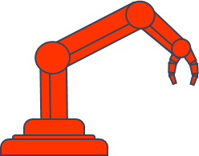
BIOMEDICAL ROBOTICS
exercise session
March 30th 2021
Ir. Michele Ambrosino
Michele.ambrosino@ulb.be
Prof. Bernardo Innocenti, PhD
Prof. Emanuele Garone, PhD

Slide 2
SUMMARY
KINEMATICS ANALYSIS:
Direct Kinematics
Geometric and Analytical Jacobian
DYNAMICS :
Dynamic Model
MOTION CONTROL :
PD Control with Gravity Compensation
Inverse Dynamics
SIMSCAPE + SOLIDWORKS

Slide 3
PREREQUISITES
ROBOT MODELLING AND CONTROL
MATLAB-SIMULINK:
MATLAB basic knowledge (use of matrices, array, functions)
SIMULINK basic knowledge (Simulink libraries)
How to simulate a nonlinear model in Simulink (see Exercise session 3 – Control System Design 2020/21)
Robotic toolbox installed (see video next slides)
Symbolic toolbox (not mandatory)

Slide 4

ROBOTICS TOOLBOX INSTALLATION

Slide 5
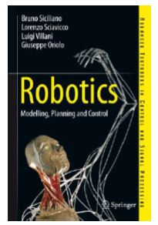
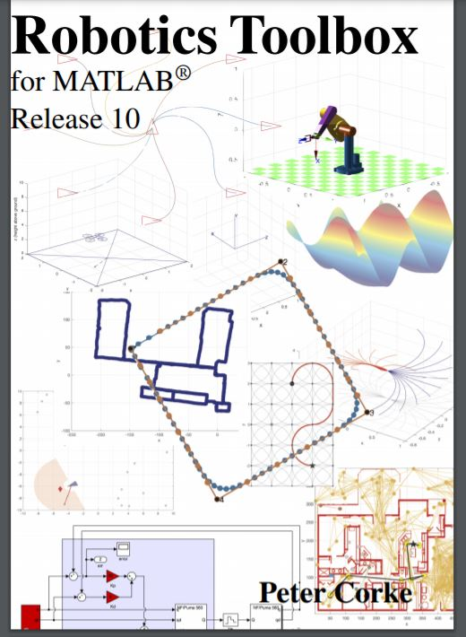
REFERENCES
TEXTBOOK
ROBOTIC TOOLBOX MANUAL
https://petercorke.com/download/27/rtb/1050/rtb-manual.pdf

Slide 6
SIMSCAPE
SOLIDWORKS to Simulink Simscape: https://www.youtube.com/watch?v=7-fkk7DU9fA
Controlling Robot Manipulator Joints: https://www.mathworks.com/videos/matlab-and-simulink-robotics-arena-controlling-robot-manipulator-joints-1521714030608.html
Physical Modeling Tutorials: https://www.youtube.com/watch?v=liIKeYxa00I&list=PLn8PRpmsu08qZutTT-7dRthkAnFuQjCOV

